Slide 1
Modeling Ozone Depletion -TOMS Data (NASA) for Latitude Bands
Dan Seth, Math, MCP
West Texas A&M University

Slide 2
Table of contents
What/Where is TOMS
What got me started looking at Ozone data modeling
Courses in which Ozone data is integrated
Sample student work and project goal from the Integrated Math and Science courses
Acknowledgements and references

Slide 3
What is/where is TOMS (NASA)? It is now at ozoneaq
http://ozoneaq.gsfc.nasa.gov/
http://npp.gsfc.nasa.gov/omps.html
Suomi NPP is NASA's next Earth-observing research satellite.
Whats in a name: Why Suomi-NPP? NASA renamed NPP in honor of the late Verner E. Suomi, U. of Wisconsin, recognized widely as "the father of satellite meteorology."
http://ozonewatch.gsfc.nasa.gov/
Ozone Hole Watch
Images, data, and information for the Southern Hemisphere
Ozone Maps Meteorology Ozone Facts Multimedia Education

Slide 4
Sample of ozoneaq site

Slide 5
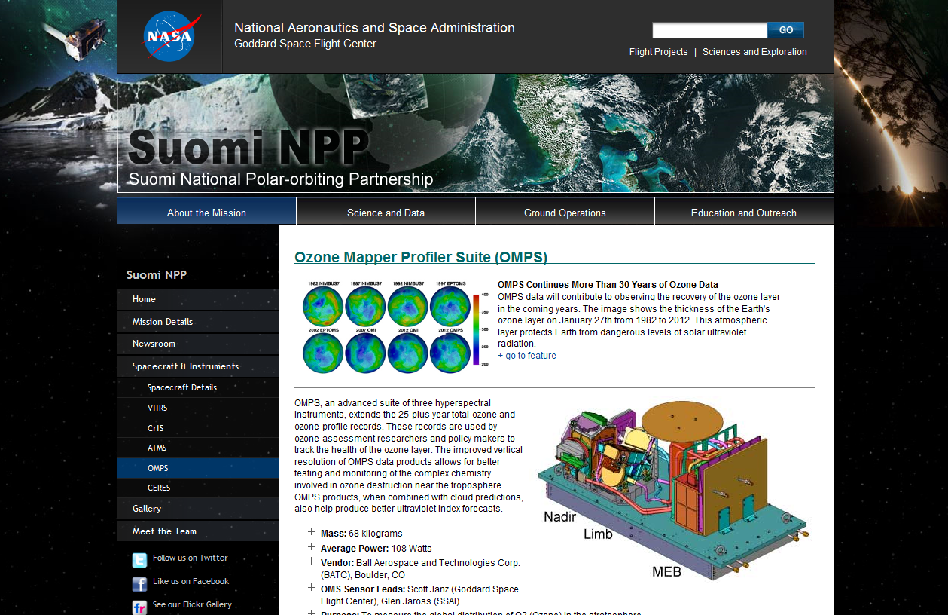
Sample of Suomi NPP site

Slide 6
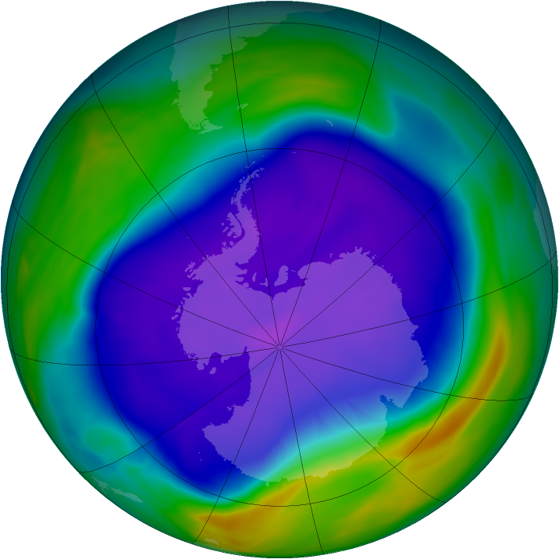
From a student favorite site: Ozone Hole Watch The largest ozone hole: 24 September 2006.

Slide 7
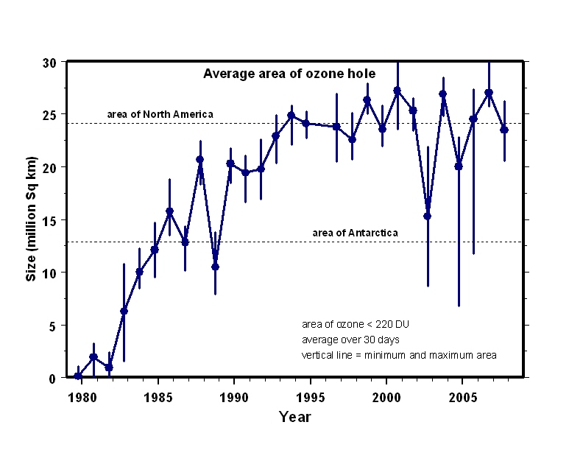
another favorite: annual ozone hole area

Slide 8
Where it all began
Developed : 331,613 - Integrated Math and Science for Teachers
NASA-NOVA grant.
Integrated mathematics, science, and technology
pre-service elementary and middle, in-service high school teachers
Goals:
Strengthen math and science content knowledge
Develop understanding of interconnections between math and science
Provide experience with innovative teaching strategies
Integrate technology to enhance learning and improve instruction
Strengthen integration of national science and mathematics standards
Use data from NASA Strategic Enterprises to enhance learning
Team taught by: Robert Boram, Physical Science; Karen Lafferty, Education; Daniel Seth, Math Sciences

Slide 9
Classroom Integration - WTAMU
Courses where Ozone data is integrated. Students make predictions and discuss relevance to their lives and the future of the planet.
College algebra – regression : linear functions from real data
Math for liberal arts – linear regression models of real data
Linear algebra (least squares theory – generalized inverse)
Future course integrations :
Elementary/engineering statistics (get data, analyze it and test regression models)
linear algebra lab (get data, develop ozone level models for cities around the world and/or ozone hole area models)
Integrated math and science for teachers – collect data and develop models, by groups, for latitude bands

Slide 10
In-Class Pre-Project to retrieve and plot TOMS data.
Get ozone data from TOMS (Total Ozone Mapping Spectrometer instruments)
Plot ozone levels for two years for different latitude bands.
1997-1998 monthly ozone averages latitude bands:
–35 to –30
+30 to +35
averaged levels
 |  | Jan 1997 | Feb 1997 | Mar 1997 | Apr 1997 | May 1997 | Jun 1997 | Jul 1997 | Aug 1997
-35 | -30 | 268.9 | 267.9 | 269.4 | 265.4 | 265.3 | 271 | 278.2 | 291.6
30 | 35 | 281.5 | 288.2 | 303.1 | 307.9 | 304 | 300.4 | 293.7 | 286.6
average |  | 275.2 | 278.05 | 286.25 | 286.65 | 284.65 | 285.7 | 285.95 | 289.1

Slide 11
Ozone Project with NASA TOMS Data
Project goals:
Model change in ozone layer over past several years.
Develop equations modeling annual ozone levels of latitude bands around the earth.
Predict future ozone levels and climatological changes.
Group Activity:
Each group is assigned a latitude band around the earth.
Determine scatter plots: years vs. average ozone levels, determine least squares regression models, use model equations to predict future ozone levels of the latitude band.
Collect models for other latitude bands from other groups.

Slide 12
Ozone Project with NASA TOMS Data
Technology:
Ozone data was collected from TOMS ozone data archives
( http://toms.gsfc.nasa.gov/ ).
EXCEL - process data, make scatter plots, determine regression model equations
EXCEL and the TI-83 graphing calculator - make predictions, evaluate the model equations for future time values, in years.
Latitude bands:
–70 through –50; –50 through –30; –30 through –10;
–10 through +10; +10 through +30; +30 through +50;
and +50 through +70

Slide 13
Sample Annually Averaged Student Data Set NASA TOMS – Latitude band: 50-70
Years | Average
1979 | 369.2342
1980 | 371.7791
1981 | 366.2628
1982 | 372.6907
1983 | 356.0907
1984 | 363.5233
1985 | 362.3605
1986 | 355.9326
1987 | 345.0379
1988 | 358.9581
1989 | 359.6186
1990 | 352.1116
1991 | 361.9395
1992 | 347.3927
1993 | 334.004
1994 | 358.4429
1996 | 310.1813
1997 | 347.2225
1998 | 366.2214
1999 | 360.8683
2000 | 356.1

Slide 14
Student Displayed Projects Math_Sci 331
Ozone Project power point: Bays, Deopke, Roark
Ozone Project poster: -30 to -10 group
Ozone Project power point: -10 to +10 group

Slide 15
Group Projects – Math_Sci 631
Latitude Band: +50 to +70
Model: y = -0.6597x + 1672.6
R squared value: 0.4552
Group comments:
Between 2009 to 2024, model shows little change in ozone levels. Studies conducted recently by the EPA suggest the opposite is true for this prediction. They have found evidence that the ozone layer is getting thinner is this band.
Prediction of Future Ozone Levels
Year | Ozone layer
2009 | 347.2627
2014 | 343.9642
2024 | 337.3672
2054 | 317.5762
2104 | 284.5912

Slide 16
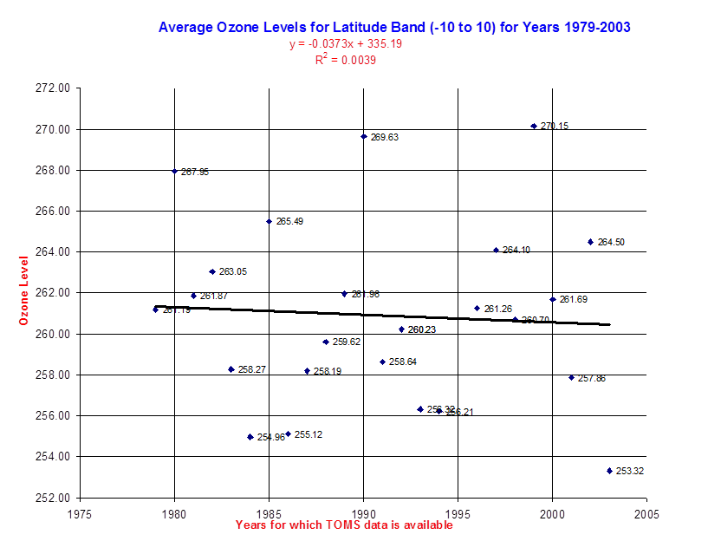
Group Projects – Math_Sci 631
Latitude Band: -10 to 10
Model: y = -0.0373x + 335.19
R squared value: 0.0039
Group comments:
R value of 0.0039 means that our data has not been modeled very well by our regression equation.
Prediction of Future Ozone Levels
Year | Ozone Level
2009 | 260.2543
2019 | 259.8813
2029 | 259.5083
2054 | 258.5758
2104 | 256.7108

Slide 17
Acknowledgements
"The data used in this effort were acquired as part of the activities of NASA's Science Mission Directorate, and are archived and distributed by the Goddard Earth Sciences (GES) Data and Information Services Center (DISC).“
Robert Boram, Department of Physical Sciences, Morehead State University, and I developed the course wherein this material was initially put together. The effort was funded under the NASA NOVA program.

Slide 18
References
ozoneaq : http://ozoneaq.gsfc.nasa.gov/
Suomi NPP is NASA's next Earth-observing research satellite : http://npp.gsfc.nasa.gov/omps.html
Ozone Hole Watch : http://ozonewatch.gsfc.nasa.gov/
TOMS The Total Ozone Mapping Spectrometer (TOMS) : http://mirador.gsfc.nasa.gov/cgi-bin/mirador/presentNavigation.pl?tree=project&project=TOMS
Goddard Earth Sciences Data and Information Services Center; Ozone: OVERVIEW : http://disc.sci.gsfc.nasa.gov/ozone

