Slide 1
The History of Philosophies of Mathematics Education: A State of the Discipline
Amy Ackerberg-Hastings
MAA Convergence
aackerbe@verizon.net

Slide 2
The History of Philosophies of Mathematics Education Within Mathematics Education Historiography
Working Definition of Philosophies of Mathematics Education
What instructors, students, and other stakeholders in various places and times thought mathematics was
Why these folks thought mathematics was an essential subject that everyone enrolled in formal education should learn
One of the Founding Documents
Charles Davies, The Logic and Utility of Mathematics, With the Best Methods of Instruction Explained and Illustrated (New York: A. S. Barnes & Co., 1850)
How Do We Know What Philosophies of Mathematics Education Existed, Where, and When?
Prevalence of Historical Scholarship That Assumes One (Usually National) Statement Was Universally Implemented
E.g., Bhesh R. Mainali, “USA Mathematics Education in the Last 100 Years: Issues, Reform, and the Lesson Learned,” British Journal for the History of Mathematics 40, no. 2 (2025): 136–155
(1 of 2)

Slide 3
The History of Philosophies of Mathematics Education Within Mathematics Education Historiography
21st-Century Maturation of the History of Mathematics Education as a Research Field
But Philosophies of Mathematics Education Remain Understudied
Alexander Karp and Fulvia Furinghetti, History of Mathematics Teaching and Learning: Achievements, Problems, Prospects (Springer Open, 2016), https://link.springer.com/book/10.1007/978-3-319-31616-1
“To what extent were the mathematics portions of these programs affected by general education theories or philosophies? Presumably the answers to [this question] will be different for different countries. But at this time most of them simply remain unanswered or inaccessible to a general international audience” (p. 11, emphasis added).
How is the History of Philosophies of Mathematics Education the Work of Historians?
How is the History of Philosophies of Mathematics Education the Work of Philosophers?
(2 of 2)

Slide 4
Yuxin Zheng, “Philosophy of Mathematics, Mathematics Education, and Philosophy of Mathematics Education,” Humanistic Mathematics Network Journal, Issue 9 (February 1994): 32–41
Philosophy of Mathematics Influences Philosophies of Mathematics Education
In the View of Mathematics
In the Analysis of the Nature of Mathematical Learning
In the Aim of Mathematics Education
Philosophies of Mathematics Education Form the Theoretical Foundation for Mathematics Education Itself
Other Readings in the Philosophy of Mathematics Education
Nataly Chesky, “Beyond Epistemology and Axiology: Locating an Emerging Philosophy of Mathematics Education,” Analytic Teaching and Philosophical Praxis 34, no. 1 (2013): 16–24
Paul Ernest, “What is ‘First Philosophy’ in Mathematics Education?” Philosophy of Mathematics Education Journal, no. 27 (2013), https://www.exeter.ac.uk/research/groups/education/pmej/pome27/index.html
Bharath Sriraman and Lyn English, “Surveying Theories and Philosophies of Mathematics Education,” in Theories of Mathematics Education: Seeking New Frontiers (Berlin: Springer-Verlag, 2010), 7–32

Slide 5
The Use of Philosophy of Mathematics in the Teaching of Mathematics
Victor J. Katz, Uffe Thomas Jankvist, Michael N. Fried, and Stuart Rowlands, eds., Introduction, Special Issue on History and Philosophy of Mathematics in Mathematics Education, Science & Education 23 (2014): 1–6
Uffe Thomas Jankvist and Steffen Møllegaard Iversen, ‘“Whys’ and ‘Hows’ of Using Philosophy in Mathematics Education,” Science & Education 23 (2014): 205–222
David W. Stinson, “Dewey, Freire, and Foucault and an Ever-Evolving Philosophy of (Mathematics) Education,” Journal of Research in Curriculum & Instruction 20, no. 2 (2016): 70–78
MAA Convergence Wants Submissions, convergence@maa.org

Slide 6
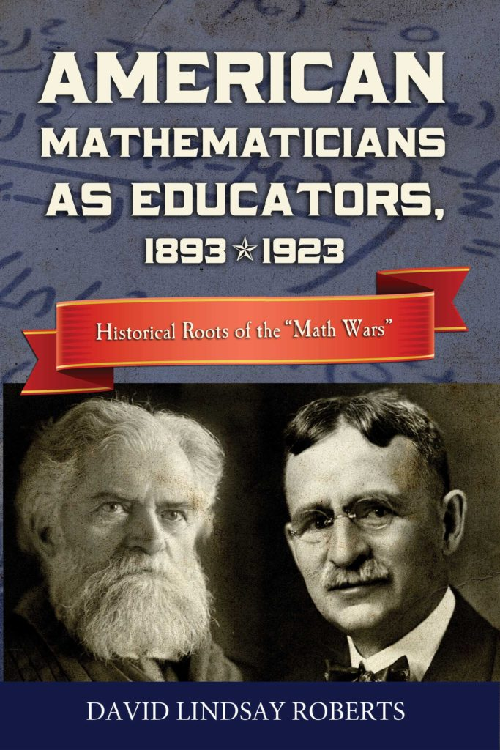
The Original Problem Remains: Researching and Writing Histories of Philosophies of Mathematics Education
Draw Upon Broad Range of Primary Sources
Policymakers, Theorists, Educators, Parents, Students, Other Stakeholders
E.g., David Lindsay Roberts, American Mathematicians as Educators, 1893–1923: Historical Roots of the “Math Wars” (Docent Press, 2012), https://www.docentpress.com/books/american-mathematicians-as-educators/
(1 of 2)

Slide 7
Potential Future Primary Sources for Debates over Philosophies of Mathematics Education
David M. Davison and Johanna E. Mitchell, “How is Mathematics Education Philosophy Reflected in the Math Wars?” The Mathematics Enthusiast 5, no. 1 (2008): 143–154
Michael R. Matthews, “Social Constructivism and Mathematics Education: Some Comments,” in Philosophy of Education 1999, ed. R. Curren (New Orleans: Philosophy of Education Society Publications Office, 1999), 330–341
Triadafillos A. Triadafillidis, “Dominant Epistemologies in Mathematics Education,” For the Learning of Mathematics 18, no. 2 (1998): 21–27

Slide 8
The Original Problem Remains: Researching and Writing Histories of Philosophies of Mathematics Education
Techniques of Book History
Authors, Readers, Publishers All Matter
Authorship, Reading, and Publishing Are Intentional Activities
Publications Are Objects As Well As Ideas
Multidisciplinarity
Techniques from the Cultural Turn in Historiography
Discourse Analysis
Thick Description
Awareness of Race, Gender, Class
Who is Missing from Statements of Educational Philosophies?
(2 of 2)

Slide 9
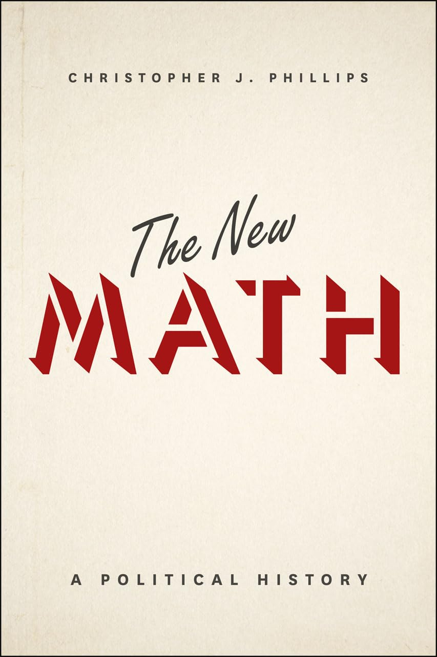
Incorporating These Methodologies into Histories of Philosophies of Mathematics Education
Christopher J. Phillips, The New Math: A Political History (Chicago: The University of Chicago Press, 2015)
Politics = The Total Set of Relationships Binding Together a Community
Competitions for Power Within Relationships
New Math Philosophies of Mathematics Education Shaped Textbook Presentations
(1 of 3)

Slide 10
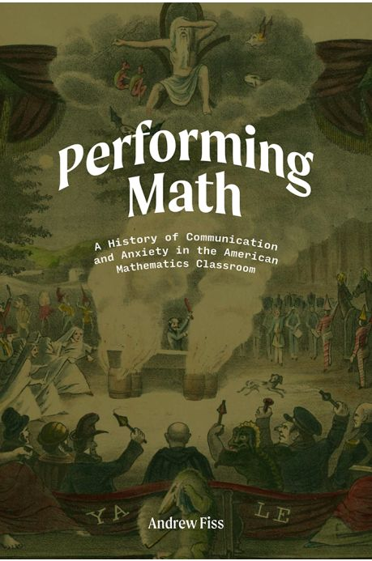
Incorporating These Methodologies into Histories of Philosophies of Mathematics Education
Andrew Fiss, Performing Math: A History of Communication and Anxiety in the American Mathematics Classroom (Rutgers: Rutgers University Press, 2020)
Communicating Mathematics is Expressing a Philosophy of Mathematics Education
Philosophies of Mathematics Education Can Create Pleasure or Anxiety
Race, Class, and Gender Are Present
(2 of 3)

Slide 11
Incorporating These Methodologies into Histories of Philosophies of Mathematics Education
Amy Ackerberg-Hastings, “Mathematics is a Gentleman’s Art: Analysis and Synthesis in American College Geometry Teaching, 1790–1840,” Ph.D. diss., Iowa State University, 2000, https://dr.lib.iastate.edu/handle/20.500.12876/66062
Amy Ackerberg-Hastings, “Analysis and Synthesis in John Playfair’s Elements of Geometry,” British Journal for the History of Science 35 (2002): 43–72
Michael Otte and Marco Panza, eds., Analysis and Synthesis in Mathematics: History and Philosophy (Dordrecht: Kluwer Academic Publishers, 1997)
Philosophical Concepts Lead to Philosophies of Mathematics Education
Nascent Book History
(3 of 3)

Slide 12
Main Ideas from This Talk
The History of Philosophies of Mathematics Education is the Work of Historians and Philosophers
Lots of Room for Further, Substantive Research
Potential Methodologies
Book History
The Cultural Turn in Historiography
Side Trips
The Influence of Philosophy of Mathematics on Current Philosophies of Mathematics Education
Interest in the Use of Philosophy of Mathematics in the Teaching of Mathematics
Four Examples of Contributions to Scholarship
Roberts, Phillips, Fiss, Ackerberg-Hastings

Slide 13
Thank You!

