Slide 1
What is the ‘Philosophy of Mathematical Practice’?
Bonnie Gold, Monmouth University (emerita)

Slide 2
The Association for the Philosophy of Mathematical Practice (APMP)
Formed in 2009
Has about 300 members
To be a member, must be nominated by two members
Meets about every 2 years; first meeting in December 2010 in Brussels
Met this January at Chapman University in Orange, California

Slide 3
APMP’s definition
A broad outward-looking approach to the philosophy of mathematics which engages with mathematics in practice (including issues in history of mathematics, the applications of mathematics, cognitive science, etc.)

Slide 4
APMP’s January 2026 meeting
6 keynote speakers
Carolin Antos-Kuby, University of Konstanz
Marc Lange, Rutgers University
John Mumma, CSU San Bernadino
Elaine Pimentel, University College London
Akshay Venkatesh, mathematician at Institute for Advanced Study
Keith Weber, Rutgers University
45 contributed talks, 2 - 3 simultaneous sessions at a time

Slide 5
Carolin Antos-Kuby
Why we should study examples: the epistemic function of exemplary reasoning in mathematics
Examples are everywhere. An example for a concept can lead to interest in the concept. Uses:
  Illustration. They can be specific: 3 is a prime number; or more general (“let n be an arbitrary integer”; the field of integers mod a prime p)
  Concept development
  Proof development
  Disproving conjectures
  Uses in proofs
  Claims of naturalness, fruitfulness, usefulness of a concept
  But we must remain mindful of danger of misuse

Slide 6
Silvia de Toffoli
Articulate Intuition
Perception
Intuition
Inference
Some intuitions share key epistemic benefits with some inferences
Articulate intuitions are intuitions that come from thinking through arguments

Slide 7
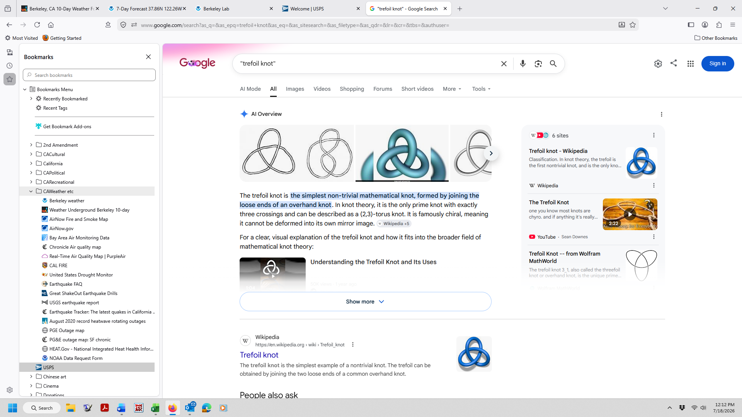
Example from knot theory
Two knots are equivalent when they can be deformed into each other without cutting. The unknot (a closed circle) and the trefoil knot are not equivalent:

Slide 8
But the trefoil knot and the second knot below are equivalent

Slide 9
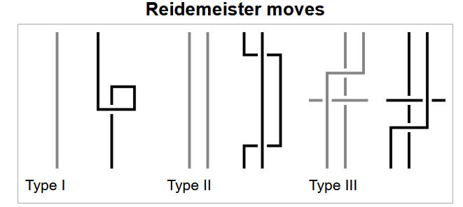
This can be shown using Reidemeister moves

Slide 10
Marc Lange
How to resolve Wigner’s mystery of the unreasonable effectiveness of mathematics in the natural sciences
He didn’t resolve it, but suggested how, sometimes, it shouldn’t be surprising
When physicists are looking for explanations, they tend to look at already-developed mathematics
For example, vector addition
Mathematicians have developed a lot of mathematics that has never been used in science.

Slide 11
Look at two related mysteries to see if they help with the use of mathematics for science
Why is mathematics so useful for developing new mathematics?
    For example, the expansion of (a + b)^{n} appearing again for the nth derivative of a product of functions
Similarly, why is physics so useful for developing new physics?
For example, the parallelogram law has many analogs

Slide 12
Akshay Venkatesh
Cryptomorphisms in Mathematical Practice
By cryptomorphism, he means a translation between two classes of mathematical statements whose psychological representations are distinct
That is, the two languages suggest different problems or solutions
What appears natural in one context is very different from what is natural in the other
They’re sort of a wormhole in the space of mathematics through which one can transpose precise mathematical statements.

Slide 13
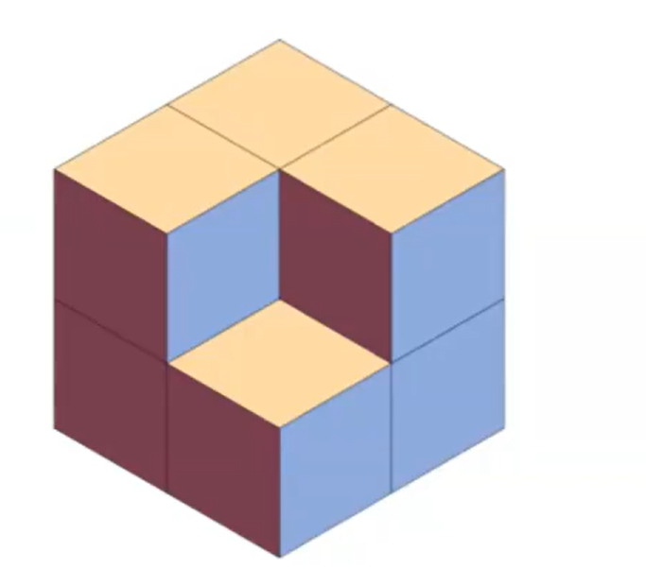
This can be seen either as a 2 by 2 by 2 stack of cubes, or as a hexagon filled by diamonds

Slide 14
Uses of cryptomorphisms
To find efficient languages or reformulations to think about questions
Especially useful for those along which one can transport proofs
Also useful in guiding the structure of a field, or choice of questions

Slide 15
A more significant example: dualities
For example, projective dualities, where any statement about points and lines is just as true if you switch the two.
There are also Fourier dualities via the Fourier transform

Slide 16
Keith Weber
Using Text to Understand Mathematical Practice in Philosophy and Mathematics Education
One can learn a lot from observing students and how they interact with mathematical texts:
How students develop certainty with respect to proofs
The relationship between proofs and certainty about the theorems
What counts as successful performance of a proof
Example: proof that 6 divides n³ – n for all natural numbers n

Slide 17

Authentic mathematical practice
Mathematical habits of mind
Confidence increasing with checking computations
Example: proof of $\sum_{k=0}^{∞}{{(\frac{−1}{4})}^{k}}\left(\frac{2}{4k+1}+\frac{2}{4k+2}+\frac{1}{4k+3}\right)= π$
What adult mathematicians do when reading/checking/refereeing proofs in mathematics articles

