Slide 1
Hempel’s Ravens and the Goldbach Conjecture
James Henderson
University of Pittsburgh at Bradford

Slide 2
A black raven, right

Slide 3
All Ravens are Black
$$∀x\left(Rx→Bx\right)$$

Slide 4
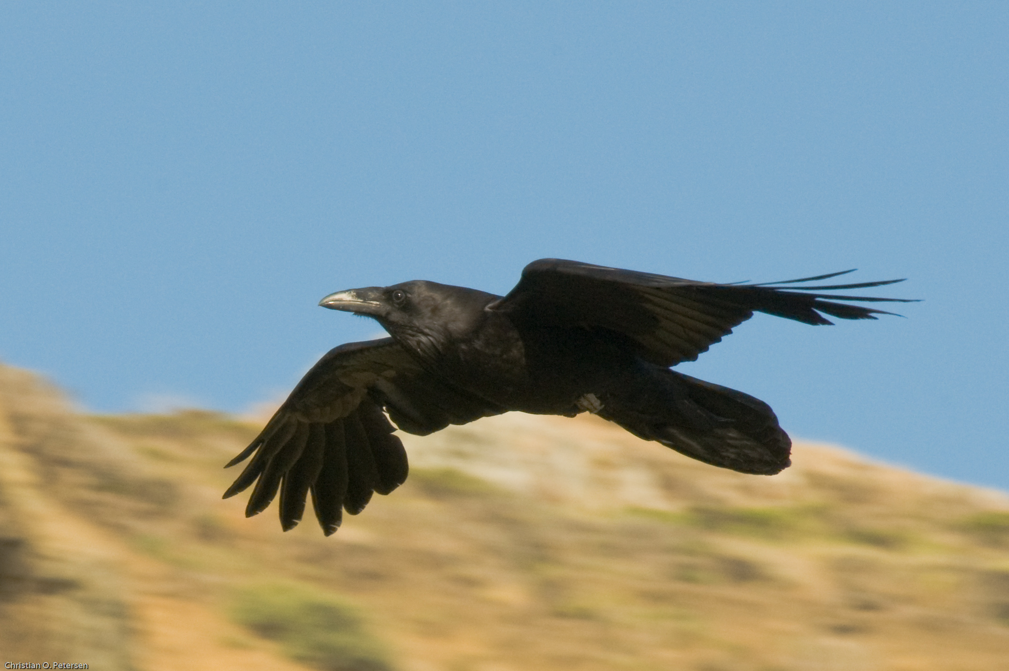

Slide 5
All non-black things are non-ravens
$$∀x\left(¬Bx→¬Rx\right)$$

Slide 6
Evidence for “All non-black things are non-ravens”

Slide 10
Evidence for
“All ravens are black”

Slide 11
All equivalent:
All ravens are black: $∀x\left(Rx→Bx\right)$
All non-black things are non-ravens: $∀x\left(¬B→¬R\right)$
Everything is black or not a raven: $∀x\left(¬Rx⋁xB\right)$

Slide 12
All equivalent:
All ravens are black: $∀x\left(Rx→Bx\right)$
All non-black things are non-ravens: $∀x\left(¬B→¬R\right)$
Everything is black or not a raven: $∀x\left(¬Rx⋁xB\right)$
… and all confirmed by Tom Selleck’s mustache

Slide 13
Hempel’s Equivalence Condition
When a proposition P provides evidence in favor of another proposition Q, then it also provides evidence in favor of any proposition logically equivalent to Q.
E.g., if $x$ is evidence for $Q$, then $x$ is also evidence for $¬¬Q$

Slide 14
Nicod’s Criterion
An instance of a generalization that “all As are B” provides a positive, confirming piece of evidence for the generalization; evidence of something that is neither A nor B is irrelevant to it, as is evidence of something that is B but not A.

Slide 15
Yep, this sodium salt is burning yellow all right

Slide 16
I saw it in the window and couldn’t resist it

Slide 23
I never saw a purple cow But if I were to see one Would the probability ravens are black Have a better chance to be one? Gellet Burgess

Slide 24
Any even integer greater than 2 may be written
as a sum of two not-necessarily-distinct primes

Slide 25
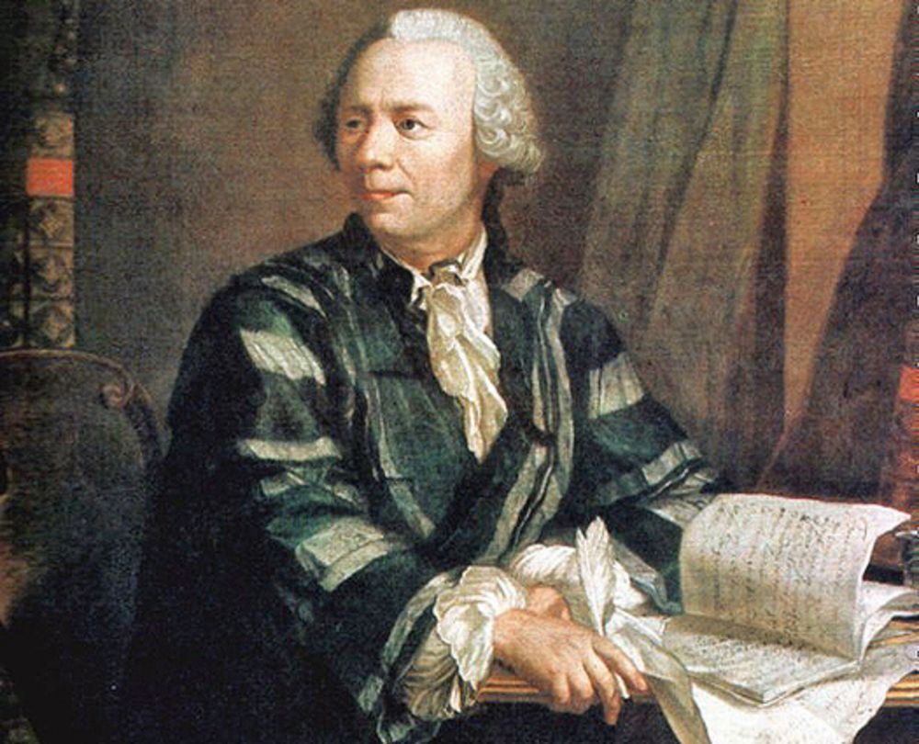
Sounds right, bruh

Slide 26
The Goldbach Conjecture
Every even number greater than 2 is the sum of two primes:
$$∀x\left(Ex→Sx\right)$$
This is equivalent to
Every number not the sum of two primes is not an even number greater than 2:
$$∀x\left(¬Sx→¬Ex\right)$$
and
Every number is either the sum of two primes or not even:
$$∀x\left(S\text{⋁ }¬E\right)$$

Slide 27
S: Summable as two primes E: Even and greater than 2
S: $\left\{4,5,6,7,8,9,10,12,13,14,15,16,18,…\right\}$
Not-S: $\left\{1,2,3,11,17,23,27,29,…\right\}$
E: $\left\{4,6,8,10,12,14,16,…\right\}$
Not-E: $\left\{1,2,3,5,7,9,11,13,15,…\right\}$

Slide 28
Hempel’s Resolution
Paradox is the product of knowledge of non-black non-ravens

Slide 29
Good’s Resolution
Paradox arises from mistaken intuition about the confirmatory power of non-black non-ravens

Slide 30
Maher’s Resolution
Sightings of non-black non-ravens suppresses the number of unobserved ravens

Slide 31
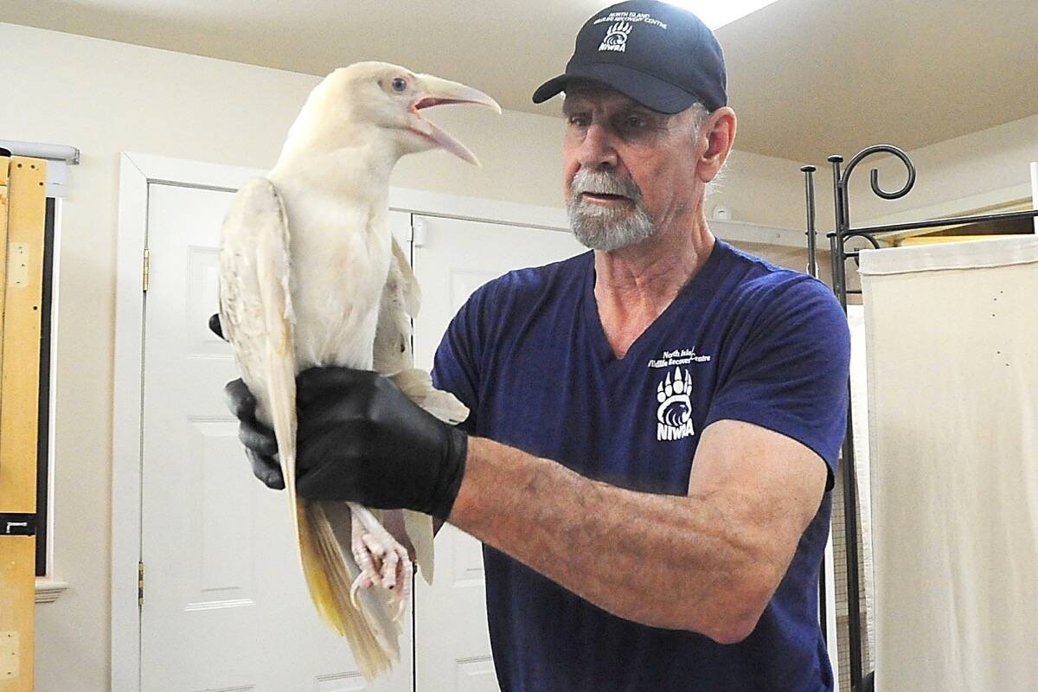
A white raven, left

