Slide 1
Why Proof is the Only Way to Acquire Mathematical Knowledge
Marc Lange
University of North Carolina at Chapel Hill

Slide 2
1. Introduction

Slide 3
1. Introduction 2. Knowledge requires more than justified high confidence in a truth

Slide 4
1. Introduction 2. Knowledge requires more than justified high confidence in a truth 3. Explanations in mathematics

Slide 5
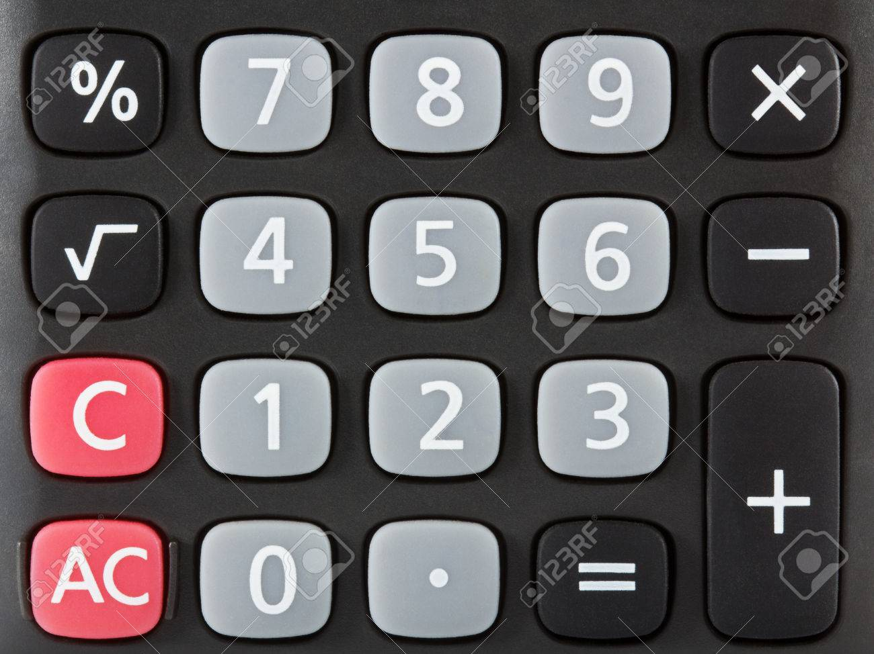
There are sixteen ”calculator numbers”: 123321, 159951, 789987, 147741,…
“A Calculator Coincidence?”, Mathematical Gazette 70(454, December 1986): p. 283.

Slide 6
The three digits from which a calculator number is formed are three integers a, a + d, and a + 2d in arithmetic progression. Take any number formed in this way – that is, any number of the form 10⁵a + 10⁴(a+d) + 10³(a+2d) + 10²(a+2d) + 10(a+d) + a. Regrouping, we find this equal to a(10⁵ + 10⁴ + 10³ + 10² + 10 + 1) + d(10⁴ + 2×10³ + 2×10² + 10) = 1111111a + 12210d = 1221(91a + 10d) = (3 × 11 × 37) (91a + 10d).
Eric Nummela 1987. No Coincidence. Mathematical Gazette 71(456): 147.

Slide 7
Consider f₁(x), f₂(x), f₃(x)…, where each function is differentiable at x = a. It can happen that f₁′(a) + f₂′(a) + f₃′(a) +… $≠$(f₁ + f₂ + f₃+…)′(a).
Why does this happen despite the fact that they are always equal for finite sums of functions differentiable at a?

Slide 8
Let’s show that if f and g are differentiable at x = a, then (f+g)′(a) = f′(a) + g′(a). By definition, f′(a) = $\lim_{h→0}{\frac{f\left(a+h\right)− f(a)}{h}}$ and g′(a) = $\lim_{h→0}{\frac{g\left(a+h\right)− g(a)}{h}}$. Let’s unpack these limits: for every ε/2 > 0, there are δ₁, δ₂ > 0 such that if |h| < δ₁, then |f′(a) $−{\frac{f\left(a+h\right)− f(a)}{h}}$| < ε/2, and if |h| < δ₂, then |g′(a) $−{\frac{g\left(a+h\right)− g(a)}{h}}$| < ε/2. Let δ be the smaller of δ₁ and δ₂ (or their common value if they are equal). Then for any ε/2 > 0, if |h| < δ, then |f′(a) + g′(a) $–{\frac{\left(f+g\right)\left(a+h\right)− (f+g)(a)}{h}}$|= |f′(a) $−{\frac{f\left(a+h\right)− f(a)}{h}}$ + g′(a)$−{\frac{g\left(a+h\right)− g(a)}{h}}$| ≤ |f′(a) $−{\frac{f\left(a+h\right)− f(a)}{h}}$|+ |g′(a)$−{\frac{g\left(a+h\right)− g(a)}{h}}$| < ε/2 + ε/2 = ε. So f′(a) + g′(a) = $\lim_{h→0}{\frac{\left(f+g\right)\left(a+h\right)− (f+g)(a)}{h}}$, which (by definition) equals (f+g)′(a). Thus we have proved that for any two differentiable functions, the derivative of their sum is equal to the sum of their derivatives.

Slide 9
To prove the analogous result for n functions, we replace ε/2 with ε/n and let δ be the member of δ₁,…,δ_{n} that is smaller than (or as small as) the rest; from among any finite number n of positive numbers, there is certain to be one that is smaller than (or as small as) each of the others.
But not so for an infinite number of positive numbers! With infinitely many functions and hence infinitely many δ_{i}, there is no guarantee that some positive number is less than or equal to every δ_{i}. Rather, the δ_{i} may approach arbitrarily close to 0.

Slide 10
That 31, 331, 3331, 33331, 333331, 3333331, and 33333331 are all prime is commonly termed a coincidence.
Spivak (1980: 482) asks why the Taylor series for $\frac{1}{1+ x^{2}}$and for $\frac{1}{1−x^{2}}$have exactly the same convergence behavior (namely, converging only if |x| < 1). Spivak cautions: “Asking this sort of question is always dangerous, since we may have to settle for an unsympathetic answer: it happens because it happens – that’s the way things are.”
The Diophantine equations 2x²(x² – 1) = 3(y² – 1) and x(x–1)/2 = 2^{n} – 1 have exactly the same five positive solutions for x -- namely, 1,2,3,6, and 91 (Guy 1988: 704).
Richard Guy 1988. The Strong Law of Large Numbers. American Mathematical Monthly 95:697-712.
Michael Spivak 1980. Calculus. 2nd ed. Berkeley: Publish or Perish.

Slide 11
1. Introduction 2. Knowledge requires more than justified high confidence in a truth 3. Explanations in mathematics 4. My proposal

Slide 12
My proposed necessary condition for an argument to supply an agent with knowledge that P is true:
The agent must justly expect that if P is false, despite the evidence marshalled by this argument, then there is a contrastive explanation of why P is false despite the evidence given in the argument.

Slide 13
1. Introduction 2. Knowledge requires more than justified high confidence in a truth 3. Explanations in mathematics 4. My proposal 5. Conclusion

Slide 14
It has … been argued, ...on what I regard as shaky philosophical grounds, that because every ordinary mathematical proof is subject to correction and human error, one ought to accept a strong probabilistic verification of primality as being a mathematical proof of primality. There is indeed reason to believe the probability is considerably greater than one in 10³⁰ that arguments accepted as mathematical proofs are in error. … There is, however, a qualitative difference between probabilistic verifi­cation and mathematical proof that is important to mathematicians. A proof is a deductive argument, in which each step follows logically from the preced­ing steps. The proof carries such weight not only because the conclusion can be seen to be valid but also because a valid conclusion must follow from the force of the argument. (Pomerance 1982:142) Carl Pomerance 1982. The Search for Prime Numbers. Scientific American 247(6): 136-147.

Slide 15
See also: Marc Lange, Because Without Cause: Non-Causal Explanations in Science and Mathematics, New York: Oxford University Press, 2017. Marc Lange, Why Proof is the Only Way to Acquire Mathematical Knowledge, Australasian Journal of Philosophy, forthcoming.

