Slide 1
Bridging the Boundary of Applied and Pure Mathematics: A Philosophic Argument for Expanding Mathematics and Scientific Disciplines via a New Numeric System
By Donald Palmer

Slide 2
Measurement = Numeric Value
299.792458 x 10⁶ meters
299.792458 x 10⁶ is the measurement with units of meters
Complex Number z = x + iy
z is the Complex Value that should equate with a measurement
x + iy involves 2 values that do not entirely equate to z (as ‘i’ is undefined)
Can we find a new numeric system that fully identifies the value of z?

Slide 3
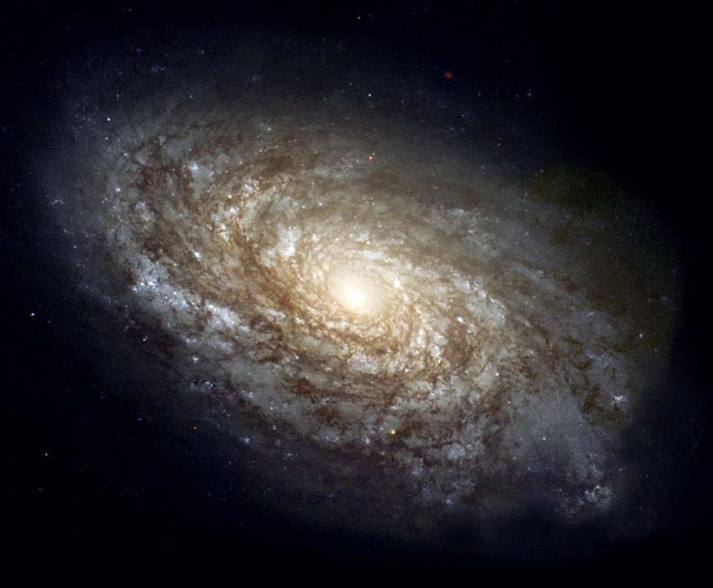
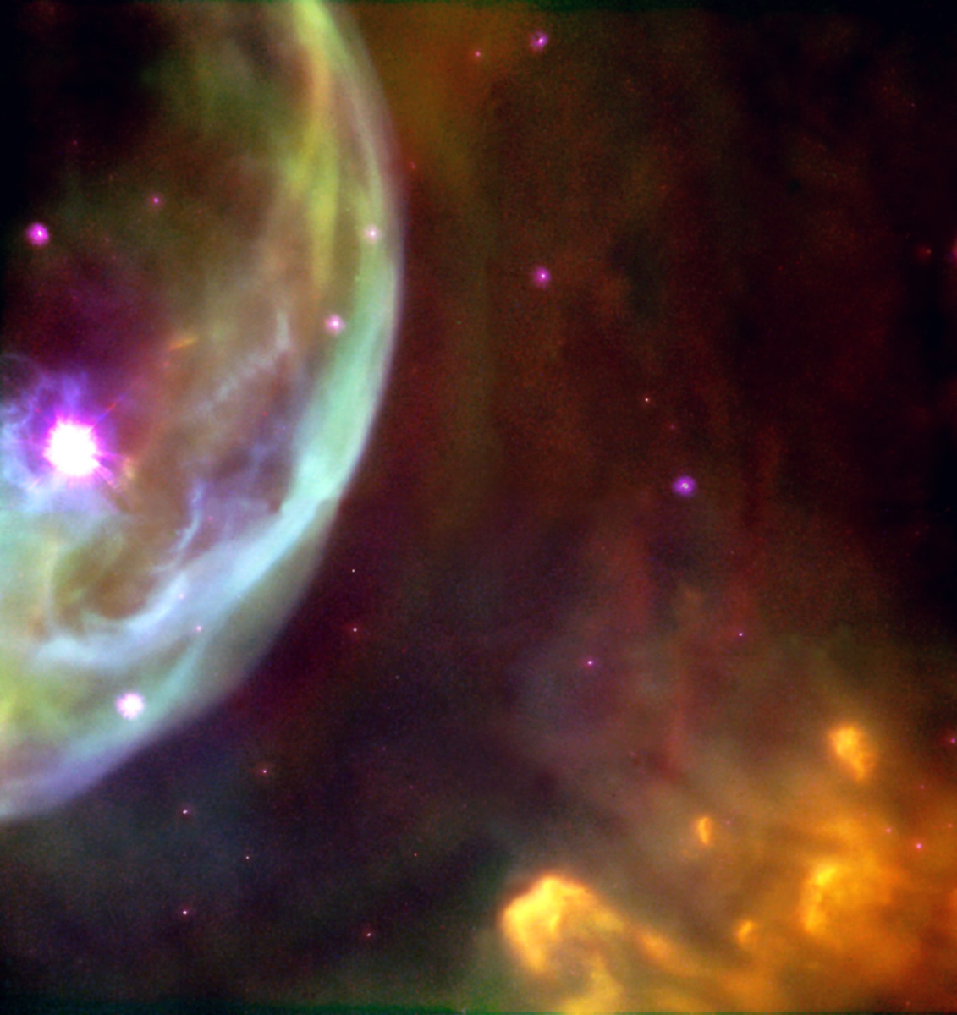
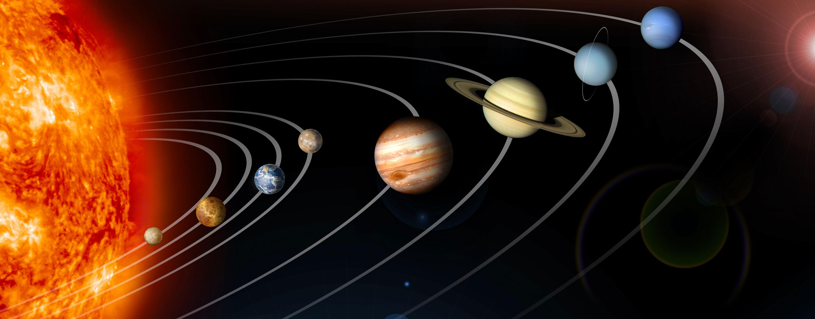
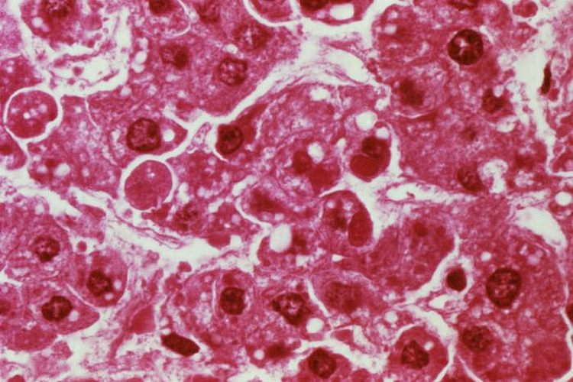
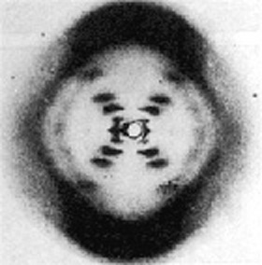
The many scales we have discovered over the past ~400 years
Galaxy
Stars
Solar System
Cells
DNA
Atom

Slide 4
Scale Continuum We study levels embedded in a 3-D Space

Slide 5
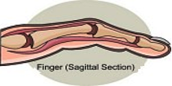
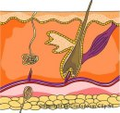
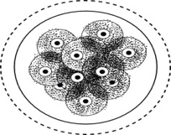
Finger at different scales Each level is filled with different scale-level objects that occupy the same 3-D volume of a finger
Z
Y
X
Z
Y
X
Z
Y
X
Z
Y
X
Z
Y
X

Slide 6
Locating Objects in Space Scale is a key element of location
10² Meters
10¹ Meters
10⁰ Meters
10⁻¹ Meters
10⁻⁹ Meters

Slide 7
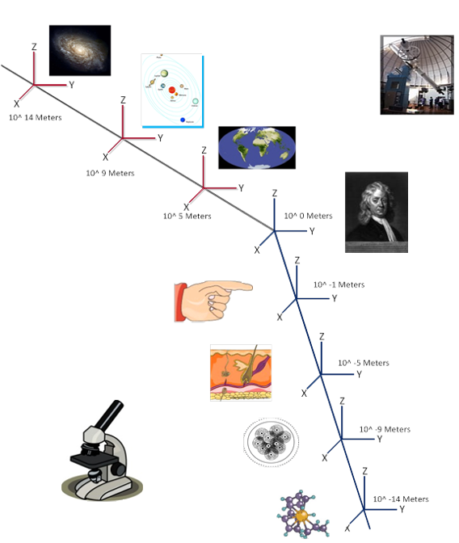
4-D Scale Space Can we measure across scale? Might there be feedback loops across scale?
10¹⁴ Meters
10⁹ Meters
10⁰ Meters
Meters
10⁵ Meters
10⁻¹ Meters
10⁻⁵ Meters
10⁻⁷ Meters
10⁻¹⁰ Meters

