Slide 1
Defining Abstraction
Rahmat Rashid, Rollins College
Mark Anderson, Rollins College

Slide 2
Motivating Ideas
From a teacher’s perspective
From a philosopher’s perspective
From a mathematician’s perspective

Slide 3
Previous Philosophical Literature
Plato vs. Aristotle
Descartes vs. Hume
More generally: rationalists vs. empiricists

Slide 4
Previous Pedagogical Literature
Piaget: Empirical Abstraction, Pseudo-empirical Abstraction, Reflective Abstraction
Gray & Tall: Empirical Abstraction, Reification, Formalization

Slide 5
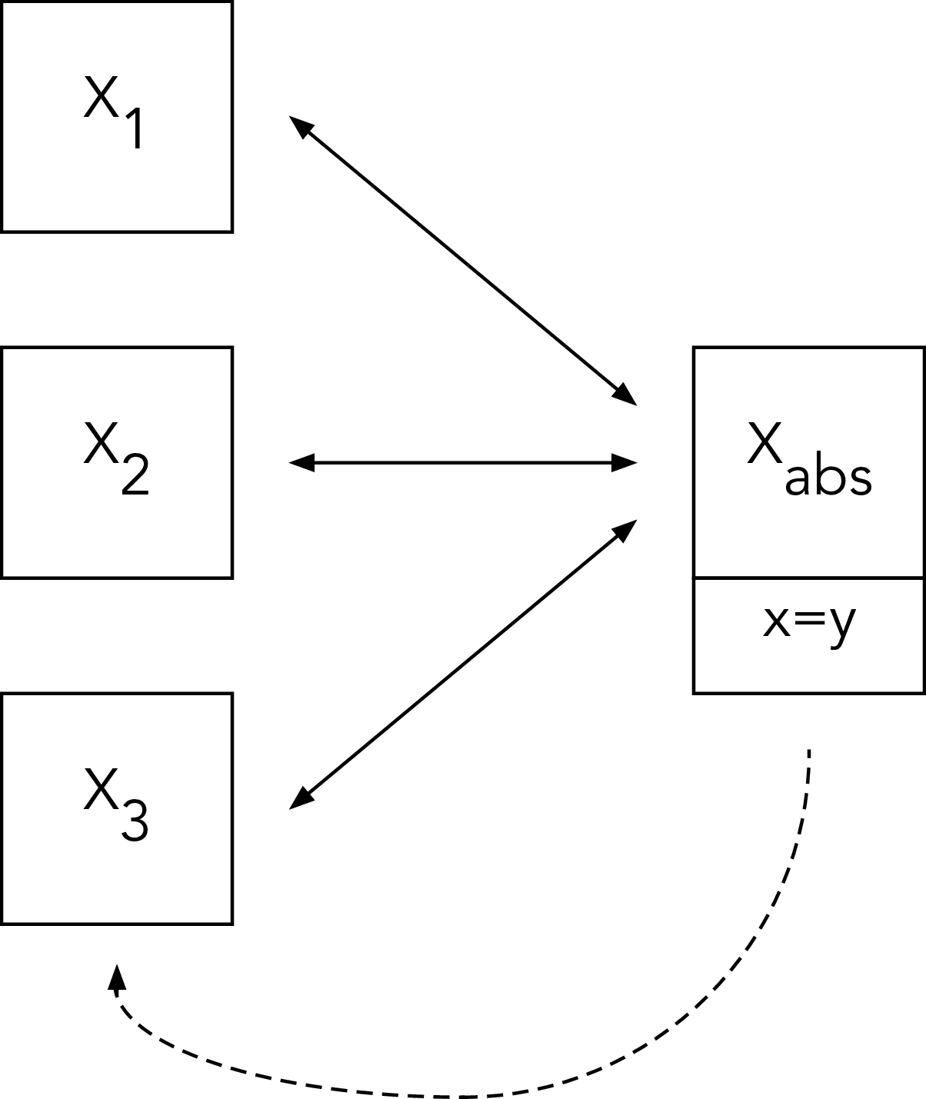
Process of Abstraction
Two phases:
Destructive Phase
Constructive Phase
Criterion of Identity (Marquis)

Slide 6
Comparing Levels of Abstraction
Forgetful Functors from Category Theory
Strictness of Criterion of Identity
B
A

Slide 7
References
Gray, Eddie, and David Tall. “Abstraction as a Natural Process of Mental Compression.” Mathematics Education Research Journal, 2007.
Marquis, Jean-Pierre. Stairway to Heaven, 2016.

