Slide 1
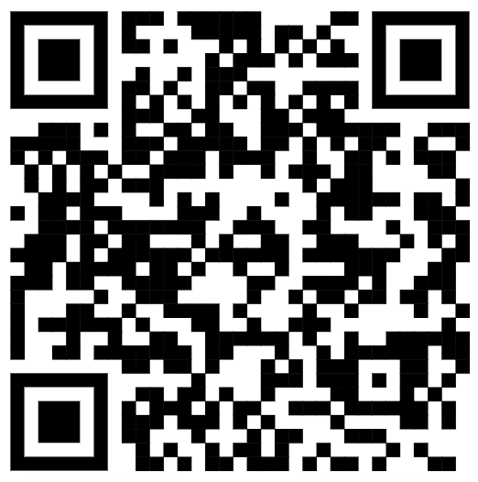
Some Remarks on
Collective Sense-Making
Ted Theodosopoulos (Nueva School)
Ongoing work in collaboration with David Spivak (Topos) and Bartek Skowron (WUT)
Mathematics & Philosophy, JMM 2024, San Francisco
http://tinyurl.com/543xmduu

Slide 2
What is sense-making?
Mathematics & Philosophy, JMM 2024, San Francisco

Slide 3
What is sense-making?
How do we recognize it?
Mathematics & Philosophy, JMM 2024, San Francisco

Slide 4
What is sense-making?
How do we recognize it?
How might it become collective?
Mathematics & Philosophy, JMM 2024, San Francisco

Slide 5
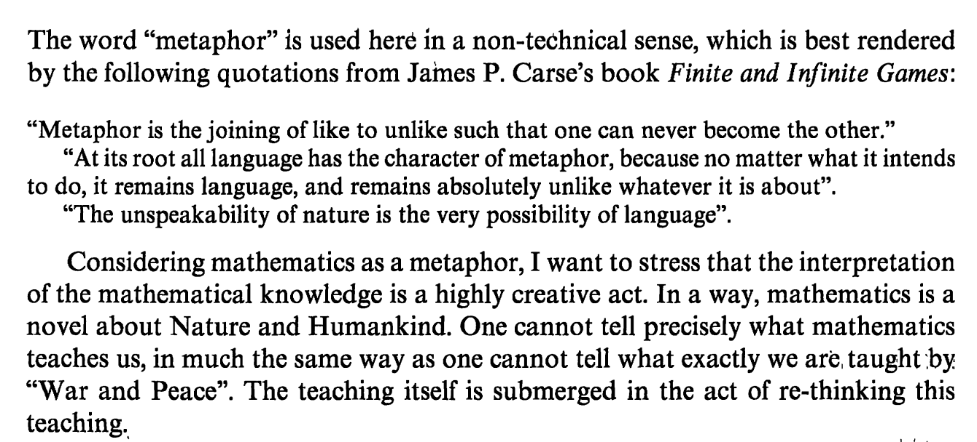
Mathematics as Metaphor
Mathematics & Philosophy, JMM 2024, San Francisco
Notes:
Sense as analogy

Slide 6
Mathematics & Philosophy, JMM 2024, San Francisco
Notes:
Standard forms and simplification

Slide 7
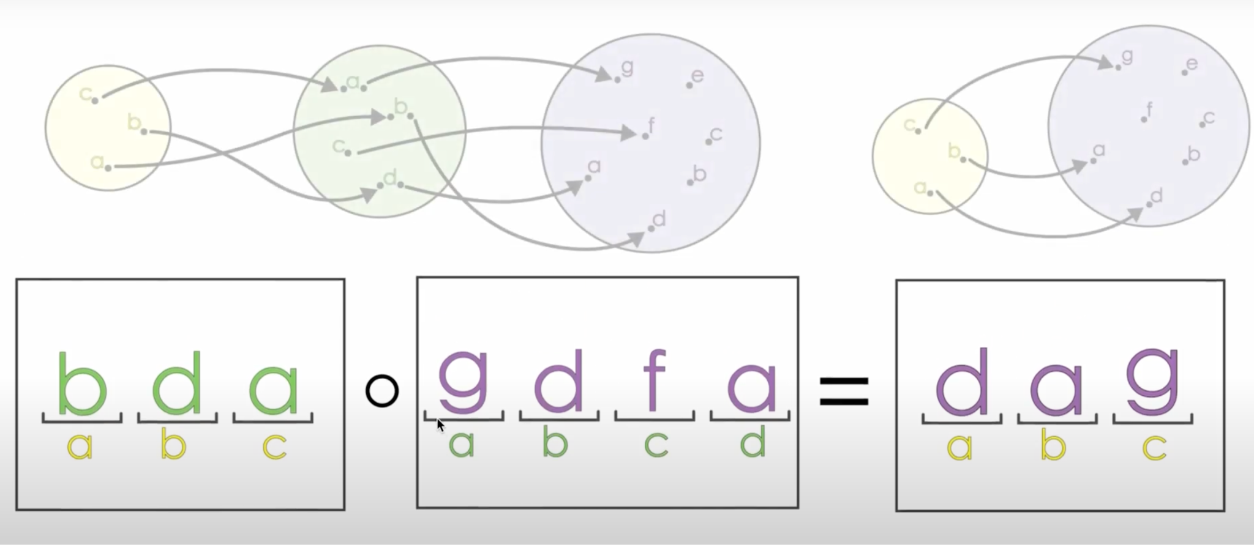
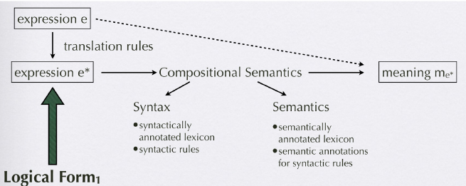
Schulz, K. (2019). Troubles at the Semantics/Syntax Interface: Some thoughts about the modal approach to conditionals. Proceedings of Sinn Und Bedeutung, 14, 388–404.
Mathematics & Philosophy, JMM 2024, San Francisco
Notes:
Composability of sense -- Katrin Schultz, Amsterdam

Slide 8
What are the obstacles to sense-making?
Mathematics & Philosophy, JMM 2024, San Francisco

Slide 9
Mathematics & Philosophy, JMM 2024, San Francisco
Notes:
Sense as story

Slide 10
Mathematics & Philosophy, JMM 2024, San Francisco
Notes:
Why vs. how

Slide 11
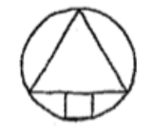
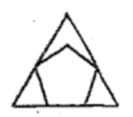
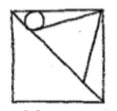
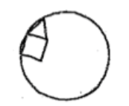
Mathematics & Philosophy, JMM 2024, San Francisco

Slide 12
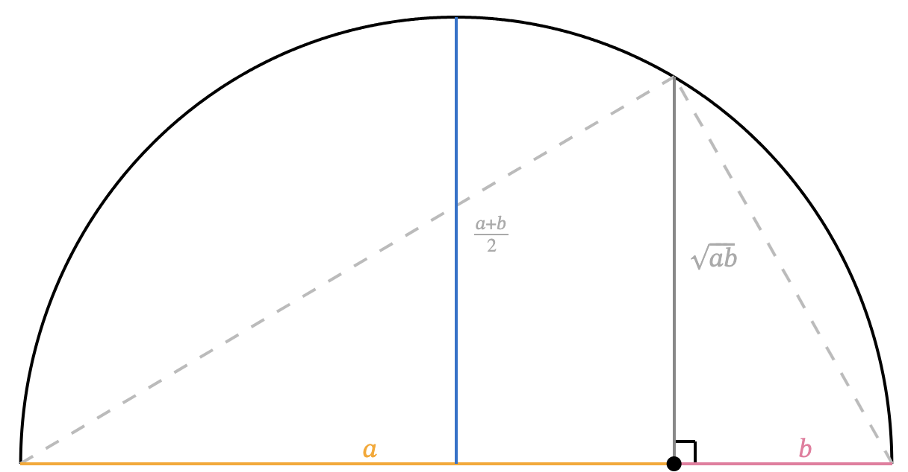
Mathematics & Philosophy, JMM 2024, San Francisco

Slide 13
Mathematics & Philosophy, JMM 2024, San Francisco

Slide 14
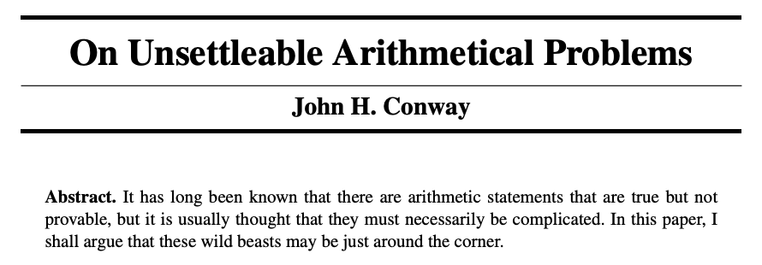
The American Mathematical Monthly, Vol. 120, No. 3 (March 2013), pp. 192-198
Mathematics & Philosophy, JMM 2024, San Francisco
Notes:
Reasonless truths

Slide 15
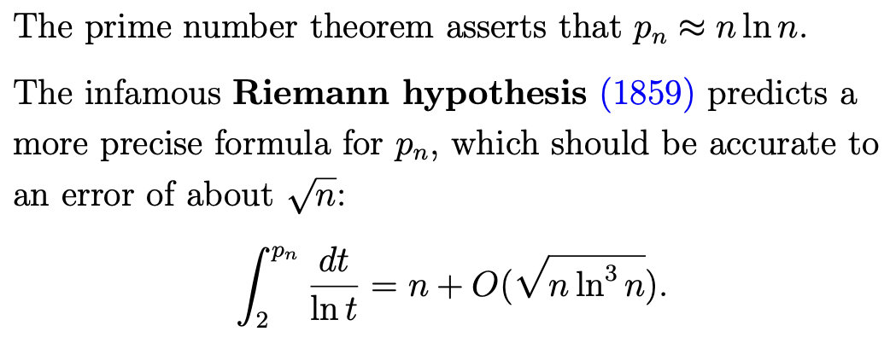
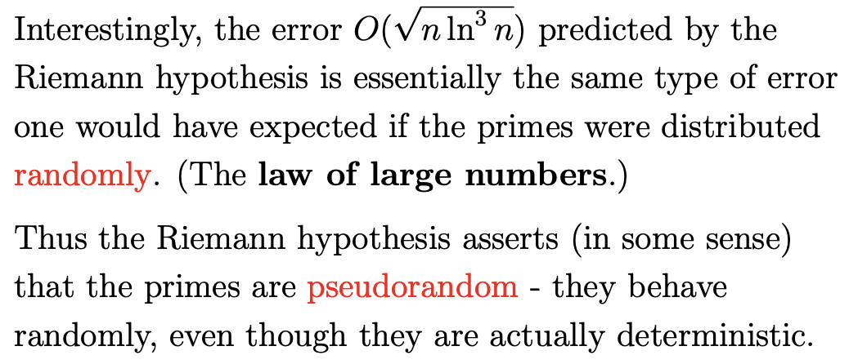
Terence Tao, Science colloquium, Jan 17, 2007
Mathematics & Philosophy, JMM 2024, San Francisco

Slide 16
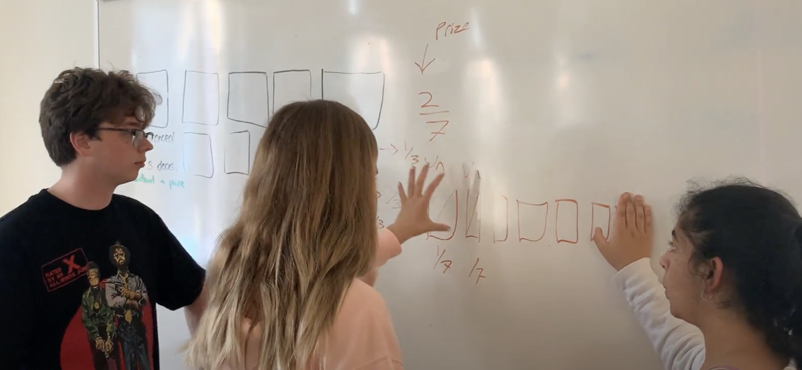
Mathematics & Philosophy, JMM 2024, San Francisco
Notes:
“Aha” moment

Slide 17
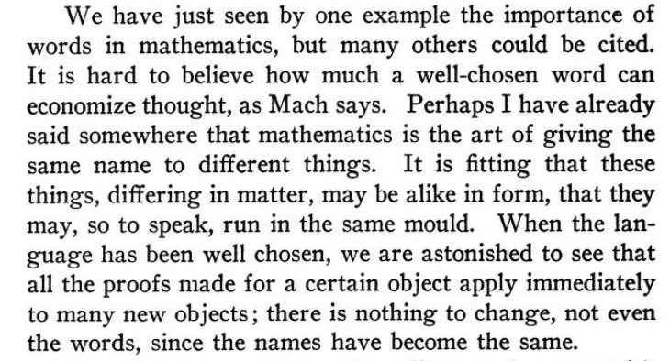
Henri Poincaré, "The future of mathematics",
The Monist, Vol.20, 1/1/1910, originally pulbished in "Revue generale des sciences pures et appliquees" in Dec. 1908
Mathematics & Philosophy, JMM 2024, San Francisco
Notes:
two things that previously seemed different might actually be aspects of the same thing

Slide 18
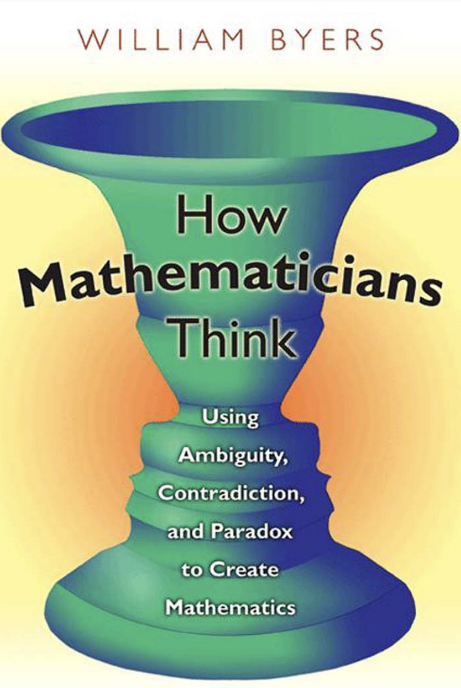
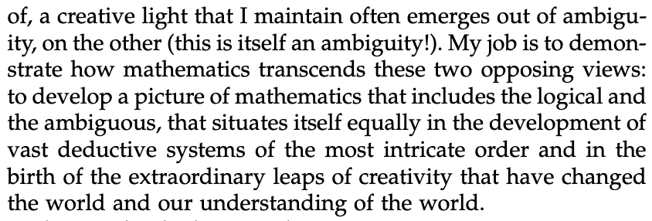
Mathematics & Philosophy, JMM 2024, San Francisco
Notes:
mathematical creativity, discovery and sense-making are the same phenomenon, observed in different contexts

Slide 19
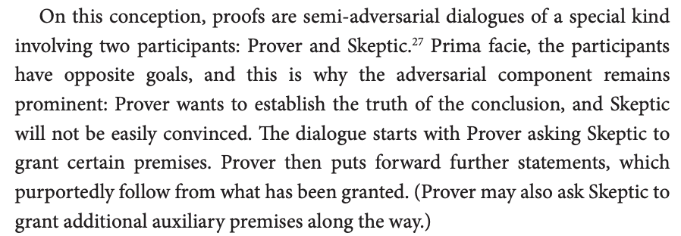
Dutilh Novaes, C. (2019). The beauty (?) of mathematical proofs. In A. Aberdein, & M. Inglis (Eds.), Advances in Experimental Philosophy of Logic and Mathematics (pp. 63-94).
Mathematics & Philosophy, JMM 2024, San Francisco
Notes:
Sense is always dialectic

Slide 20
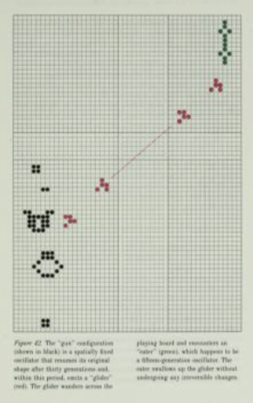
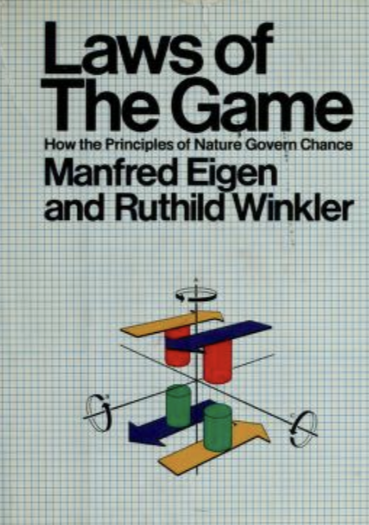
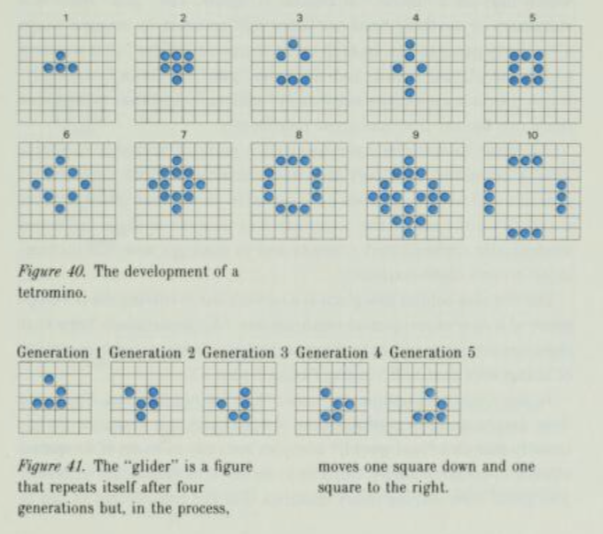
Gardner, Martin (October 1970). "The fantastic combinations of John Conway's new solitaire game 'life'". Mathematical Games. Scientific American. Vol. 223, no. 4. pp. 120–123.
Mathematics & Philosophy, JMM 2024, San Francisco
Notes:
Sense-making is contextual, like a game

Slide 21
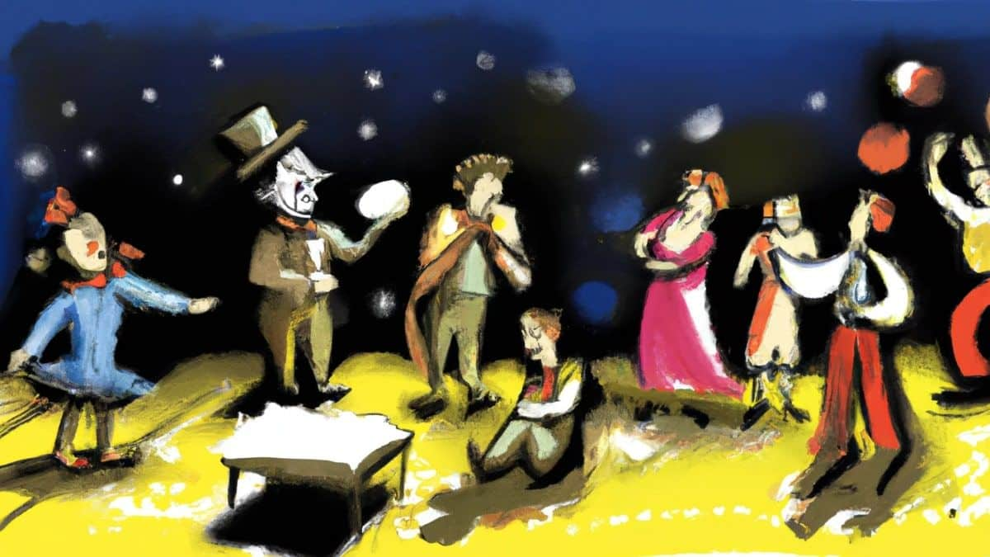
Mathematics & Philosophy, JMM 2024, San Francisco
Notes:
Theater game

Slide 22
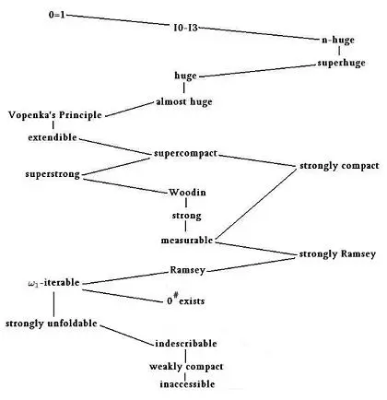
Hierarchy of large cardinals
Chris Lambie-Hanson, Point at Infinity blog, Ultrafilters VII: Large Cardinals, 2016.
Mathematics & Philosophy, JMM 2024, San Francisco
Notes:
willing into existence that which holds all our contributions as distinct facets

